Slide 1


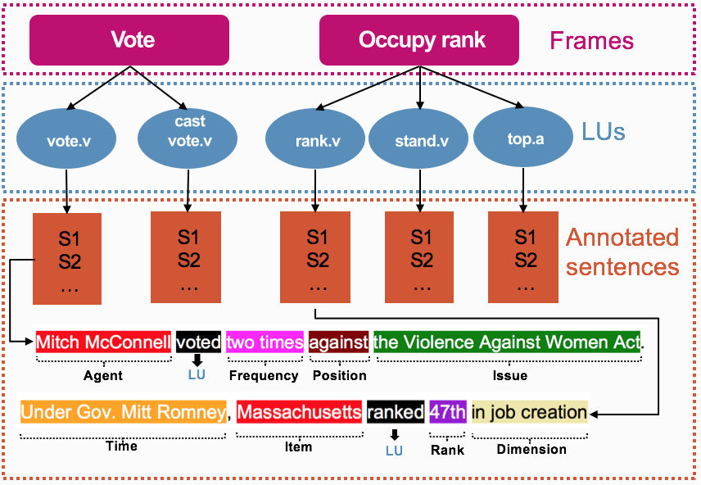
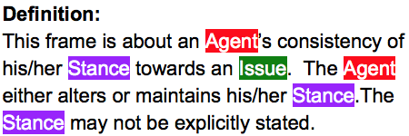
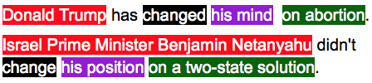
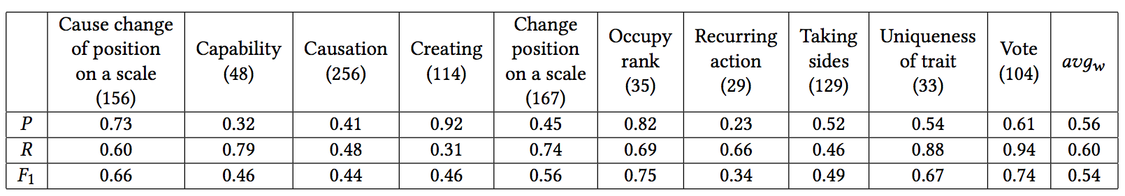
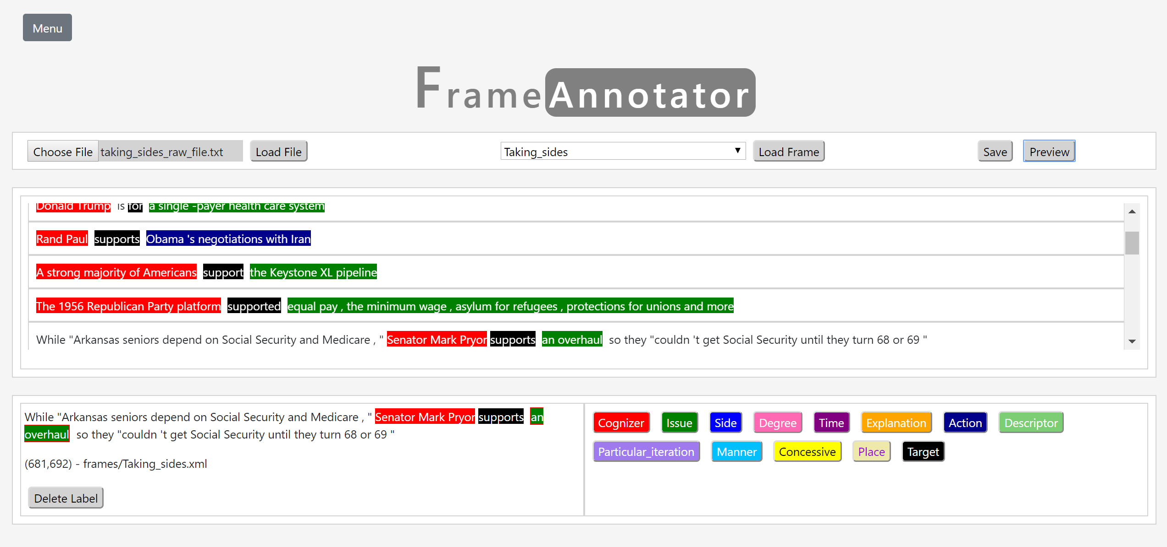
Modeling Factual Claims with Frames
The Innovative Database and Information Systems Research Laboratory (IDIR)
Fatma Arslan, Damian Jimenez, Josue Caraballo, Gensheng Zhang, Chengkai Li
Introduction
Modeling Factual Claims
A growing interest in automating various fact-checking steps.
We introduce an extension of FrameNet (Baker et. al., 1998) for structured and semantic modeling of factual claims.
With such modeling capability, we can capture various aspects of a factual claim; the domain and topic of the claim, the entities involved and their relationships, quantities, comparisons, aggregate structures, and so on.
This claim modeling capability is useful for a variety of steps for automating fact-checking, e.g., detecting factual claims, matching claims with fact-checks, translating claims to structured queries, and so on.
Defining New Frames
Collected fact-checked claims from PolitiFact¹ ,
Examined a subset of these claims one by one.
Grouped claims similar in nature.
Created new frames for each claim group if it doesn’t already exist in FrameNet collection.
20 frames (13 newly created)
900 labelled factual claims.
Figure: Vote and Occupy rank frames from our frame collection along with their LUs. An exemplified sentence for vote and rank Lus with color-coded frame annotations below. Labels below each sentence are frame specific frame elements (FEs).
Oppose and Support Consistency Frame
Preliminary Experiments: Claim Detection
Task: Identifying factual claims to be fact-checked.
Utilized open-sesame² for frame identification.
Retrained it on FrameNet 1.7 dataset along with annotated sentences for three new frames .
Labelled factual claims from “Share the Facts” dataset³ for 10 frames.
Evaluated open-sesame’s performance for claim detection.
Table: Frame prediction performance, in terms of Precision (P), Recall (R) and F-measure (F1). Where avg_{w} denotes the weighted average of corresponding measure across ten frames.
Conclusions and Future Work
Uniqueness of trait and Vote frames performed in line with other pre-established frames.
Model’s performance can be improved by feeding more training data.
Developed a frame annotator tool to annotate more data for further experiments.
Funding:
This research has been partially supported by National Science Foundation grant #1719054 and a subaward from the Duke Tech & Check Cooperative (funded by The Knight Foundation, the Facebook Journalism Project and the Craig Newmark Foundation). Any opinions, findings, and conclusions or recommendations expressed in this publication are those of the authors and do not necessarily reflect the views of the funding agencies.
1. https://www.politifact.com 2. https://github.com/swabhs/open-sesame 3. http: //www.sharethefacts.org/

